Slide 1
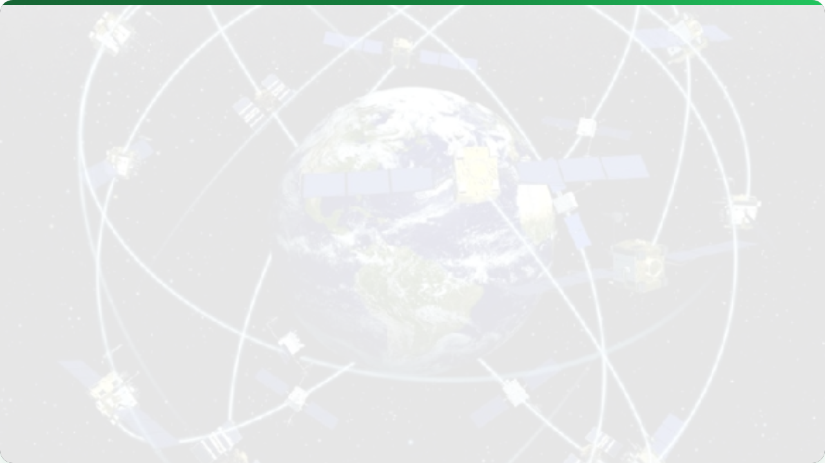



GIS & GNSS BASICS
Lecture 2: Mapping the Farm
AGE 418
Dr. Kadeghe Fue

Slide 2




Lecture Roadmap
Geographic Information Systems
GNSS / GPS
What is GIS?
How Satellite Positioning Works
The "Layer Cake" Concept
Sources of Error
Vector vs. Raster Data
Differential Correction (RTK)

Slide 3
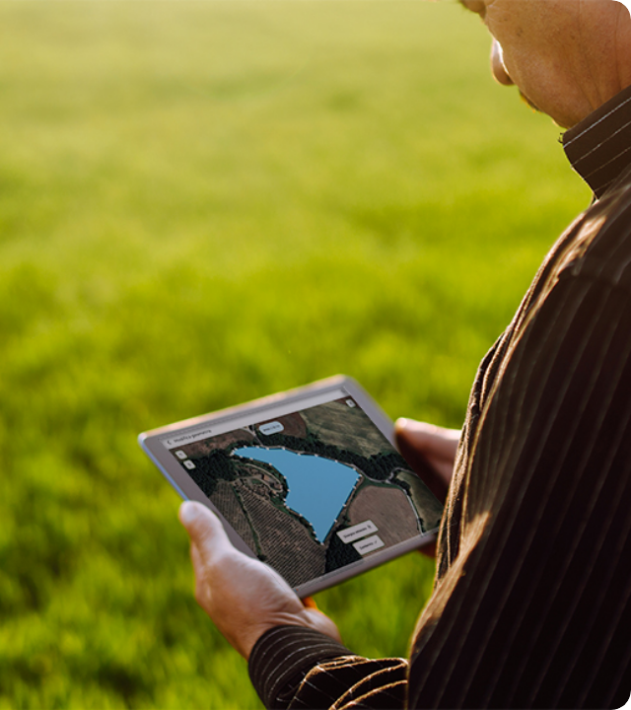
What is GIS?
Geographic Information System (GIS) is the "Digital Twin" of our physical fields. It allows us to:
Capture: Record spatial data from sensors.
Analyze: Find patterns (e.g., low yield in sandy soil).
Visualize: Create maps for decision making.
"It organizes chaotic farm data into actionable layers."

Slide 4

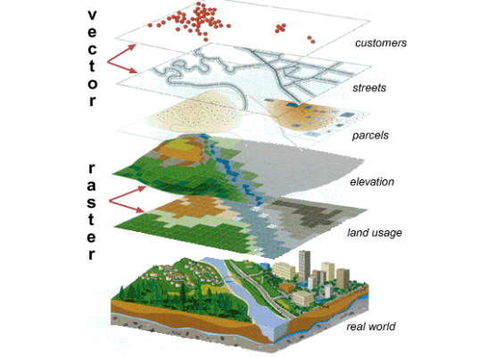
The "Layer Cake" Concept
GIS separates the real world into thematic layers. We stack these to discover relationships.
Layer 1 (Top): Yield Data
Layer 2: Soil Type
Layer 3: pH Levels
Base: Real World Field
Analysis happens where these layers intersect.

Slide 5

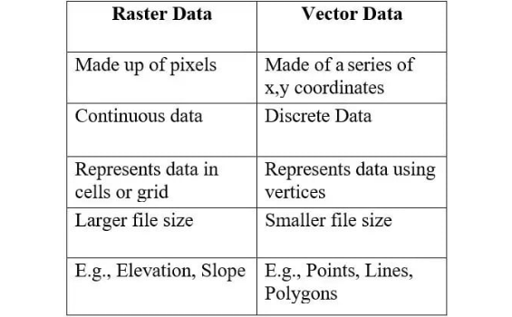
Data Models: Vector vs. Raster
Vector Data | Raster Data
Discrete objects (Coordinates) | Continuous grid (Pixels)
Points (Wells) Lines (Roads) Polygons (Boundaries) | Satellite Imagery Elevation Models (DEM) Yield Maps

Slide 6

GNSS Fundamentals
Global Navigation Satellite Systems
GPS is just one system (USA). In modern agriculture, we use GNSS receivers that track multiple constellations:
🇺🇸 GPS 🇷🇺 GLONASS 🇪🇺 Galileo 🇨🇳 BeiDou

Slide 7
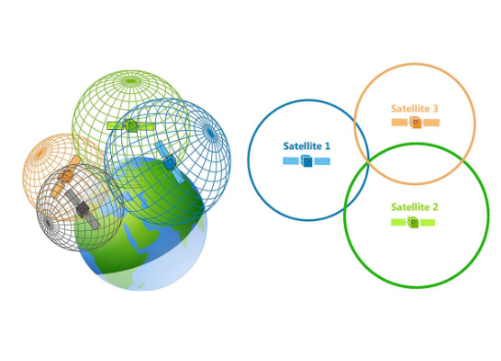
How it Works: Trilateration
The Math of Location
Satellites broadcast a Time-Stamped signal.
Receiver calculates distance:
Distance = Speed of Light × Time.
3 Satellites: Gives a 2D fix (Lat/Long).
4 Satellites: Gives a 3D fix (Lat/Long + Altitude).

Slide 8



Sources of Accuracy Error
Standard GPS is only accurate to ~5 meters. Why? Because space is messy.
Atmosphere
Multipath
Clock Errors
The Ionosphere and Troposphere slow down the satellite signal, throwing off the "Time" calculation.
Signals bouncing off trees, hills, or buildings before hitting the receiver create "ghost" signals.
Tiny nanosecond misalignments between satellite atomic clocks and receiver clocks.

Slide 9
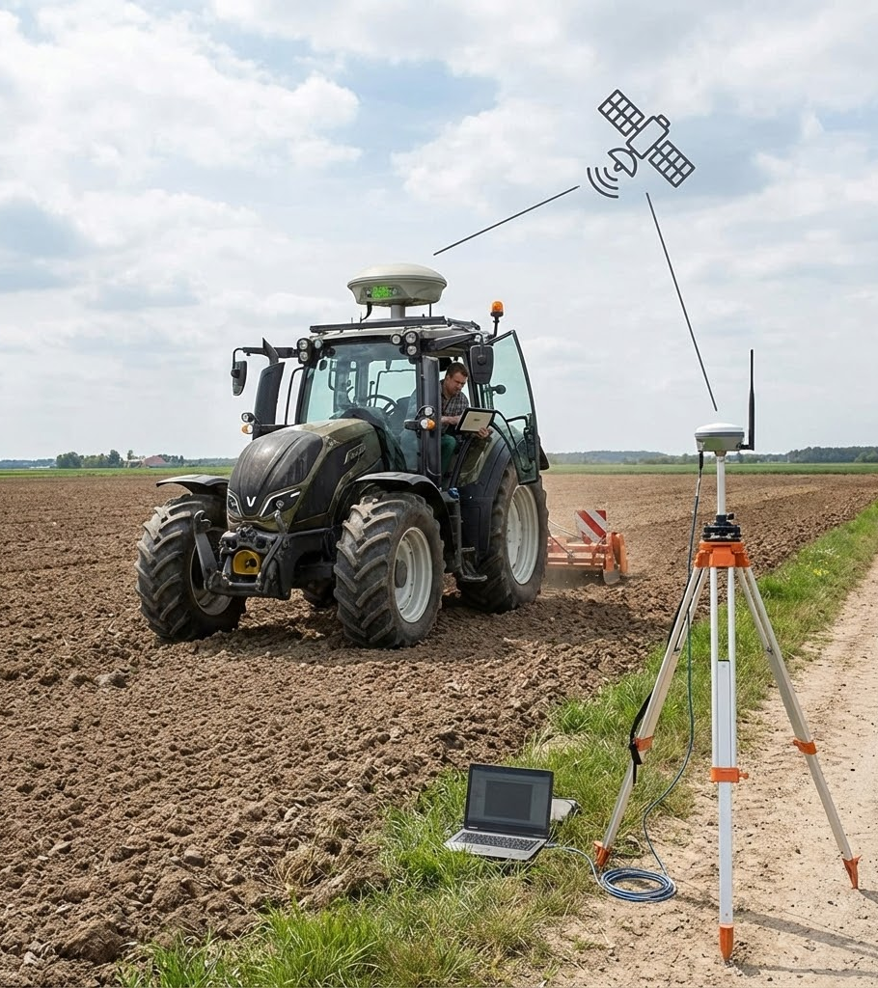
The Solution: RTK
Real-Time Kinematic (RTK)
To achieve the 2.5 cm accuracy needed for auto-steer, we use differential correction:
Base Station: A fixed receiver on the farm (known location) calculates the real-time error.
Correction Signal: Base sends corrections to the tractor (Rover) via radio/internet.
Result: Pinpoint accuracy for planting and weeding.

Slide 10


Coordinate Systems
Geographic (GCS)
Projected (PCS)
Units: Degrees (Lat/Long)
Units: Meters (UTM)
Curved surface of the earth. Great for defining where something is globally.
Flattened map. Essential for calculating Area (hectares) and Distance in the field.
"Always project your data before calculating acreage!"

Slide 11

Lecture Summary
GIS
GNSS
RTK
The system for managing spatial layers. Understanding Vector vs. Raster is key for data management.
Uses trilateration from multiple satellite constellations to determine position.
The gold standard for PA. Uses a base station to correct errors, achieving centimeter-level accuracy.

Slide 12


Questions?
Dr. Kadeghe Fue | AGE 418
Sokoine University of Agriculture

